Slide 1
Principals as Marketers
PRESENTED BY Rich Neimand and Dave Clayton
September 09, 2015

Slide 2
School choice means that principals must be active marketers of their schools and the value of state and county investment in public education.

Slide 3
Voters clearly want to invest more in local schools, teacher salaries and professional development—principals can be a catalyst for securing more public support.

Slide 4
Principals are universally seen as leaders who bridge the gulf between the “system” and the frontline experiences of students, families and teachers.

Slide 5
Principals don’t need more to do, just a focused strategy and message that makes it easier for them to connect all their existing efforts to build greater support for their schools.

Slide 6
Marketing public schools

Slide 7
Context
The state is on the hook for the negative state of public education, but schools are not off the hook for delivering a product that satisfies parent aspirations and provides the public with value.

Slide 8
Strategy
Local schools must continue student and parent-centric messaging of their value while voicing need for the resources to produce well-rounded, self-sufficient students who are prepared for success in college, career and life.

Slide 9
Understand that parents are
anxious about their role as providers of competitive life advantages to their children.

Slide 10
Elevate the conversation to talk about the common goals for each child, before talking about the ways to achieve them.

Slide 11
Focus on challenging each child
to progress to their next level through dedicated teachers and
a supportive school culture that prepares a child for college,
career and life.

Slide 12
Education is not a system, it is
a personal growth experience
for parents and children that is
made possible by smart and compassionate people working
together to help actualize personal and social goals.

Slide 13
First and foremost, give parents confidence by delivering emotional outcomes with education outcomes.

Slide 14
Illustrate the every day miracles happening in your schools—stories about moments of transformation will transform perceptions about your value.

Slide 15
If parents don’t feel personal love, they feel their children won’t get it—parents need to be welcomed as active partners in their child’s development and school and be made a part of the club that isn’t just the homework club.

Slide 16
Demonstrate how much parents
in your schools care about their children, their progress and your schools.

Slide 17
Address institutional needs through the need to move each child ahead—support for teachers, assistants and programs comes when they are framed as essential to providing a complete education that prepares each child for college, career and life.

Slide 18
Take the competition head on—get softer with the emotional packaging of public schools while getting harder on accountability for charters, vouchers and private schools.

Slide 19
Educators and satisfied parents are the best advertising vehicles—connect them around shared values, empower them to tell their stories and you’ll gain greater support for your schools.

Slide 20
Outreach made easy

Slide 21
You only need a few well-placed people sharing the same message to create a community echo chamber and positive momentum for your school.

Slide 22
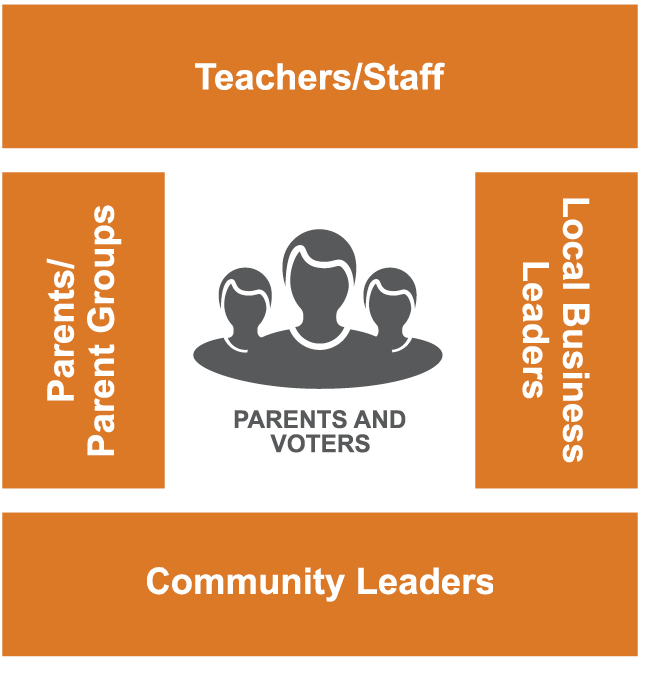
Influence box

Slide 23
Identify the people inside and outside your school who provide parents and voters with confidence: teachers, staff, active parents, business leaders, faith leaders, community groups.

Slide 24
Recruit two or three members of each key group to become an ambassador for your school.

Slide 25
Key determinants: Influence, capacity, likelihood to participate—go for the low hanging fruit.

Slide 26
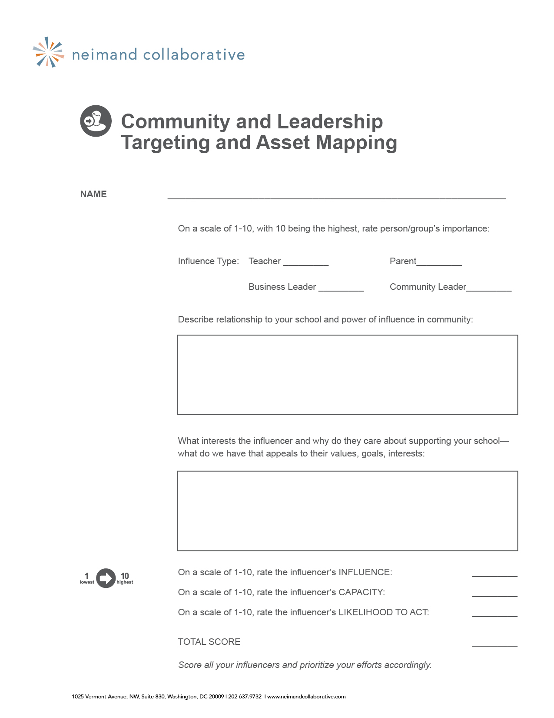
Asset
mapping

Slide 27
Arm your ambassadors with a primary message about your school, emotional success stories and secondary messages that motivate their constituencies.

Slide 28

Messaging
Handout
http://www.zsr.org/articles/public-education-messaging

Slide 29
Motivating motivators

Slide 30
Teachers:
• Parents and the public value your work and trust your voice.
• They want what you want: better pay for teachers, more professional development and greater funding to provide a well-rounded education for children.
• Promoting the value of our school will help us retain students while building public support for the state and local funding you deserve and children need.

Slide 31
Parents:
• Your voice outside our school is just as important to your child’s success as your voice inside our school.
• Other parents look up to you and respect your opinion—you can help them make the best decision for their child by talking about your experience in our school.
• Promoting the value of our school will help us attract and retain students while building public support for the state and local funding we need to make sure each child reaches his
or her potential.

Slide 32
Business leaders:
• Public education drives our local and state economy.
• The public values our local public schools and believes they need more state and local support.
• Being a champion for our local public school sends a clear message that you care about your community, its children and economic future.

Slide 33
Community leaders:
• Strong and successful local schools are the best way to create successful individuals and a better community.
• Parents and voters value our local schools and want the state to invest more in our teachers and children.
• Local schools hold our community together—it’s time to talk about the success being made by our children, parents, teachers and schools. When we do, we’ll get the support
we need to make sure each child is prepared for
college, career and life.

Slide 34
Thank you

